Slide 1
HYSTEROSCOPIC MYOMECTOMY
Dr.E.Askary
Assistant professor of OB &GYN
Shiraz University of Medical Sciences, Shiraz, Iran

Slide 2
Indication:
Abnormal uterine bleeding,
Infertility, and early pregnancy loss
Suspected intra-uterine pathology
Dysmenorrhea,
and pelvic pain
Scope diameters,
Fluid management,
Tissue removal systems,
and Electrosurgery

Slide 3
Increased aromatase activity in leiomyoma tissues, leading to increased growth and development
The rate of growth of a fibroid decrease with age in Caucasian women but not in African American women
Other risk factors:
Family history,
obesity,
alcohol intake,
soybean product consumption,
red meat consumption,
hypertension, and
vitamin D deficiency

Slide 4
Preoperative Assessment
In the presence of bleeding, other causes of it should be investigated, from hematological, functional, or neoplastic causes.
Information about the issues mentioned above and the desire for future pregnancy, which would lead to consideration of conservative surgery.

Slide 5
Physical examination
A proper physical examination is essential to rule out other causes for AUB.
Vaginal atrophy should be addressed and
Gross lesions of the cervix and the vagina, such as polyp or a prolapsed myoma, should be evaluated.
During the physical examination, patients’ tolerance to exam is assessed to aid in decision making of whether they can be candidates for office hysteroscopy.

Slide 6
Imaging
Transvaginal and pelvic ultrasound, hysterosonography, and MRI of the pelvis Hysterosalpingography
Ultrasonography (USG), especially (TVUS), is the routine exam and is usually the first one performedwith good accuracy, easy access, and low cost,
Limitation: in the presence of a large uterus or multiple nodules, as posterior acoustic shadowing makes it difficult to evaluate and count them.
It is important in the evaluation of the intramural component of the myoma and the free myometrial mantle up to the serosa, but it is operator-dependent

Slide 7
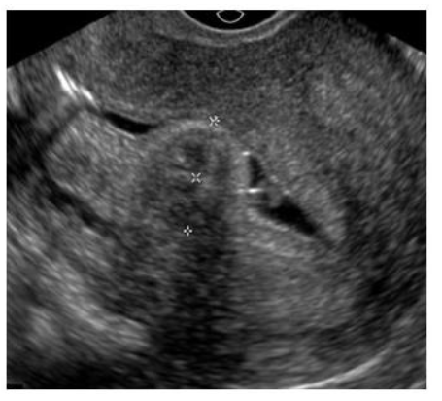
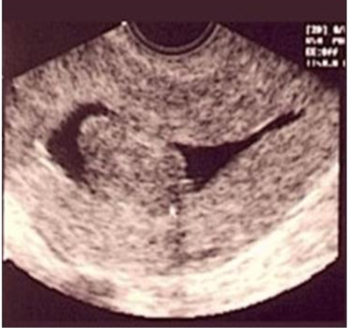
Hysterosonography and HYCOS, an ultrasound procedure performed with the uterus distended with saline solution for greater contrast and detailing of the uterine cavity, is more accurate than TVUS in identifying the uterine cavity.

Slide 8
MRI?
(MRI) of the pelvis is indicated in uteri with a volume greater than 375 cm3 or with more than four fibroids.
With excellent definition regarding the number, location, size of nodules, and proximity to other myomas, it is used to diagnose adenomyosis and adenomyoma, rule out non-fibroids and sarcomas, and to measure the myometrial mantle.
The myometrial mantle refers to the distance between the deepest portion of the myoma in the myometrium and the serosa.

Slide 9
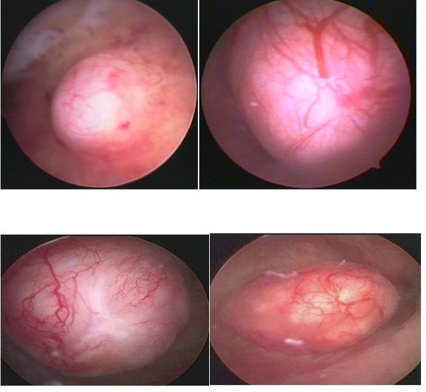

Slide 10
Classification
There are currently two main classifications: the ESGE, described by Wansteker et al. in 1993, and the Lasmar—STEP-W, published in 2005.

Slide 11
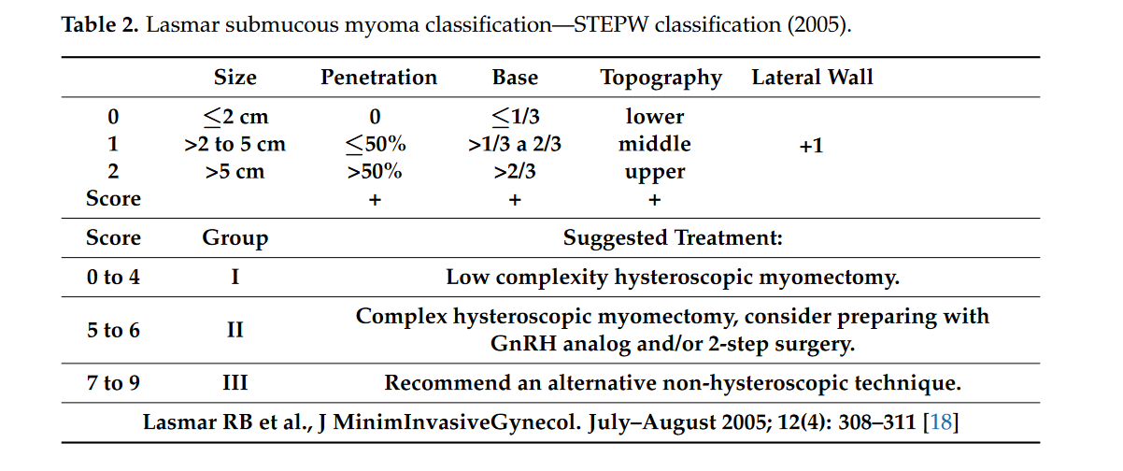

Slide 12
How to evaluate each parameter of the Lasmar classification:
Size of the nodule.
Location.
Extension of the myoma base in relation to the affected wall :
When the myoma base affects 1/3 or less of the uterine wall, it receives a score of 0; when the base of the nodule occupies 1/3 to 2/3 of the wall, the score is 1 and, when it affects more than 2/3 of the wall, the score is 2.
Uterine wall: Myoma of the anterior and posterior wall receives a score of 0, while the one located on the lateral wall scores 1.

Slide 13
Consideration:
Myoma mobilization is more useful in fibroids with greater penetration into the myometrium, while morcellation techniques are favorable in larger fibroids.
Fundic and cornual fibroids can be challenging regardless of the technique.

Slide 14
Hospital hysteroscopic myomectomy is a highly complex procedure, being associated with the risks of bleeding, uterine perforation, incomplete surgery, pelvic organ injuries, and intravasation.
Anesthesia can be sedation in myomectomies with shorter operative time and spinal block in those with a longer time,
There is greater control of the patient’s level of divided into fibroid enucleation and fragmentation or myolysis.

Slide 15
Using of resectoscope
resectoscope, regardless of the type of energy,
Planned loop movements always in the fundus–cervical direction, with the angulation of the resectoscope axis to define the degree of resection depth.
These two movements have to be thought out and prepared before activating the energy so that only the myoma is resected, avoiding resection of the myometrium and the risk of perforation, and so that the penetration of the cut is as desired.

Slide 17
Slicing Technique
The principle of the slicing or slicing technique is the partial and progressive removal of the myoma, in fragments,
Starting at its surface and gradually working towards its base. Slices of myoma are removed with the semicircle loop in the mono or bipolar resectoscope, moving it energized, from the fundus to the cervix.
With monopolar energy, non-electrolytic media are used, which are 1.5% glycine, mannitol, and mannitol/sorbitol, while, with bipolar energy, the electrolytic media, physiological solute 0.9%, and ringer lactate are used

Slide 18
Due to the crowding of myoma fragments in the uterine cavity, it is necessary to interrupt the procedure with emptying of the cavity, so that the vision of the cavity and the myoma is recovered.
The regulation of the electrosurgical generator is cut-coagulation and blend determined by the surgeon’s need for each case and according to each generator, varying cut from 60 to 120 W and coagulation from 40 to 60 W.
Remember that the speed of movement of the loop can also determine the action of more cutting or more coagulation;
The faster moving loop cuts more and coagulates less, while the slower one coagulates more than it cuts.

Slide 19
Morcellator Technique (Hysteroscopic Mechanical Tissue Removal)
Hysteroscopic Tissue Removal Systems (TRS) perform fragmentation and suction of endometrial pathology, such as polyps and fibroids.
There are three main brands currently available on the market (e.g., Myosure, Truclear, and Symphion) and they are mainly used for types 0 and 1 intrauterine leiomyomas.
Hysteroscopic tissue removal systems introduced an efficient, easy-to-use tool for hysteroscopic myomectomy.
Limitations: high cost of the disposable element, and the difficulty resecting fundal fibroids and deep type 2 fibroids
Dense and calcified fibroids can be very challenging to resect with these devices.

Slide 20
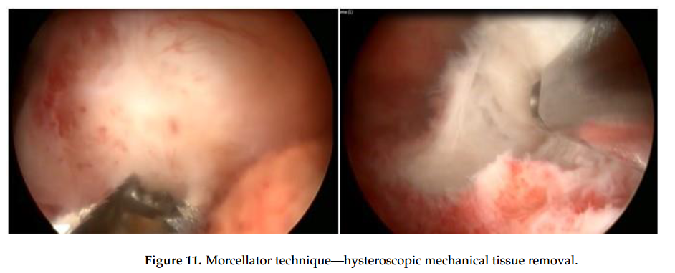

Slide 21
Laser technique
LASER will lead to myolysis with total destruction of the myoma and late expulsion of it after volume reduction and ischemia.
Therefore, it can be considered for nodules with a greater intramural component, in which surgery with a resectoscope could pose risks.
The most common type of LASER used in hysteroscopy is the diode laser device, with a 5 Fr fiber, capable of mixing two different wavelengths, 980 nm and 1470 nm.
A 980 nm wavelength is more absorbed by hemoglobin, leading to a higher coagulation effect. At 1470 nm, we will have a higher vaporization effect.

Slide 22
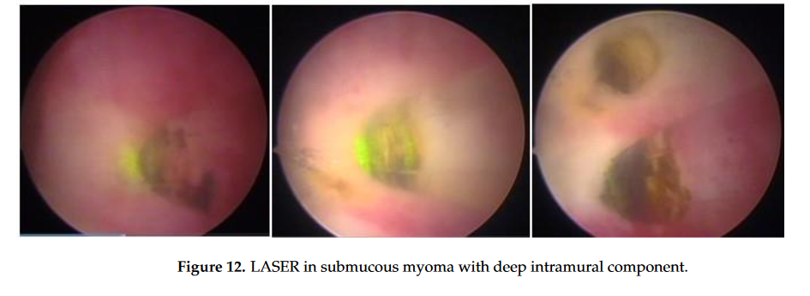

Slide 23
Radiofrequency Ablation Technique
This is also a myolysis technique, which is applied through ultrasound guidance.
The system uses a handpiece for radiofrequency ablation, connected to an intrauterine ultrasound probe, forming a single integrated device so that the rods penetrate the myoma.
This real-time ultrasound integration allows the physician to visualize and target as many fibroids as possible so they can be addressed

Slide 24
Mazzon’s technique micircle loop, with mono or bipolar energy, until reaching the intramural portion of the myoma. Upon reaching the pseudocapsule, the loop is changed to a more rigid one, which is not energized (cold loop), so that the myoma is mechanically mobilized until its enucleation. Then, a loop with energy returns to fragment and remove the myoma.

Slide 25
Regardless of the technique, some fibroids will not be removed in a single operative time;
Some procedures should be interrupted for safety, reinforcing the importance of preoperative assessment of the patient’s clinical conditions and classification of the fibroid
Mainly in patients with infertility, outpatient second-look hysteroscopy is indicated 45 to 60 days after surgery to review the uterine cavity and lyse the adhesions, which may appear with the procedure and will be easily lysed with scissors or with the simple passage of the hysteroscope?????
As operative bleeding is one of the most frequent risks in hysteroscopic myomectomy, the patient with severe anemia should not undergo surgery until the anemia has been corrected

Slide 26
Complications of Hysteroscopic Myomectomy
The incidence of complications in hysteroscopic myomectomy ranges from 0.8 to 2.6%
Laceration of the cervix can occur at the time of dilation due to the positioning of the Pozi forceps and with the Hegar dilators, with dilation difficulty, especially in those who used GnRH before the procedure and in older patients.
Revision of the laceration site, with tamponade and/or suturing of the area, has excellent results.

Slide 27
Uterine perforation :at the time of cervical dilatation or during surgery; when perforation occurs without the use of energy, only clinical observation, with the patient hospitalized for a few hours, is sufficient.
With the impossibility of uterine distention, the procedure must be suspended and the patient returns to the operating room in 3 months.
If energy was used at the time of perforation, regardless of which, the indication for investigation of the pelvic and abdominal cavity is imperative, even with the great possibility of being negative.
Laparoscopy or laparotomy may rule out bowel and/or bladder injuries.

Slide 28
Bladder injury: may be suspected in the presence of hematuria, as the patient with complex myomectomy has bladder catheterization for fluid balance.
Hematuria will only happen when the anterior wall of the uterus is perforated, but it can happen lightly when the bladder catheter is moved, which should be evaluated with cystoscopy before considering laparoscopy.

Slide 29
Decreased the risk od Uterine Perforation
For reduce the possibility of uterine perforation at the time of cervical dilatation, some
Precautions should be taken:
1—Perform the bimanual exam to assess size, version, and uterine flexion.
2—Perform previous diagnostic hysteroscopy to identify the path and
Start dilatation with Hegar’s dilator # 4.
3—Remove the speculum after clamping the cervix with the Pozzi forceps and facilitate
the rectification of the path.
4—Use dilators with a 0.5 cm diameter progression.
5—Limit with your index finger how much of the dilator will progress into the uterine cavity—
The dilation is for the internal os only; there is no need to advance the Hegar dilator to the fundus of the uterus.

Slide 30
Uterine bleeding
Uterine bleeding can happen due to the superficial vessels of the myomas or from the myometrial bed.
The treatment, as previously described, consists of vessel coagulation, anti-hemorrhagic drugs, oxytocin, and placement of an intracavitary Foley catheter, with a well-distended balloon, for 4 to 12 h, always with patient monitoring.

Slide 31
Fluid Overload
Strict fluid balance is important, with great care from 1000 mL of negative balance, avoiding reaching 2000 mL.
Rapid and massive absorption of fluids can lead to pulmonary edema, heart failure, encephalopathy, brain damage, seizures, coma, and death.
When using 1.5% glycine, massive absorption initially causes nausea, vomiting, and dizziness.
The severity of complications is directly associated with the volume absorbed in a short period of time.
Prolonged surgical time can also increase absorption of the distention medium.

Slide 32
Some researchers use vasopressin and oxytocin to decrease the chance of intraoperative intravasation and bleeding, still awaiting further studies proving the effectiveness .

Slide 33
Other complications
Infection is not frequent in hysteroscopic surgeries; in myomectomy, it is possible due to the presence of residues, which could become infected, and the occlusion of the internal os, leading to the formation of hematometrium and pyometra.
Air embolism is rare but it can be serious and fatal. Ambient air may be responsible, penetrating the venous circulation, during dilation of the cervical canal or through a solution of continuity in the myometrium, with greater risk with the patient in the Trendlenburg position, where the heart is below the level of the uterus.
The risk of air embolism is similar in hysteroscopic myomectomy and other types of hysteroscopic surgery.
The gas produced in bipolar vaporization with physiological solute is similar to that in monopolar vaporization with 1.5% glycine and does not appear to be responsible for causing embolism.

Slide 34
Late complications
Adhesions and placenta accreta, especially in areas of large resections.
Some authors describe the incidence of adhesions after hysteroscopic myomectomy ranging from 1 to 13% .
the post-surgery hyaluronic acid intrauterine gel others the placement of a nonhormonal intrauterine device.???
What all services recommend is a review of the uterine cavity at 45 to 60 days postoperatively to review the uterine cavity and lysis of adhesions, especially in the patient who desires to conceive.??????

Slide 35
Take home message
Safety in myomectomy is at two distinct moments,
in the preoperative evaluation and in the operative act.
In the preoperative period, it consists of the hemodynamic evaluation of the patient, the knowledge of the desire for a future pregnancy, and the classification of the uterine fibroid.
We described all cautions in the time of operative act.

